Slide 1
Miniproject I
Niklas Bergen
July 23, 2021
Notes:
Include introduction to yourself on this slide

Slide 2
Outline
Objectives
Tools Used
Results
Challenges

Slide 3
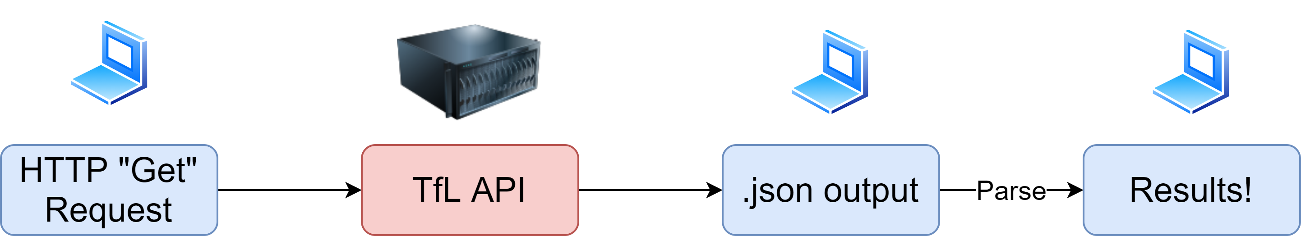
Objectives
Test API functionality

Slide 4


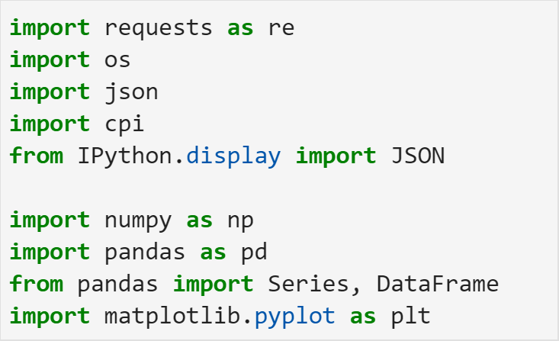

Tools Used
Jupyter Lab
Packages

Slide 5
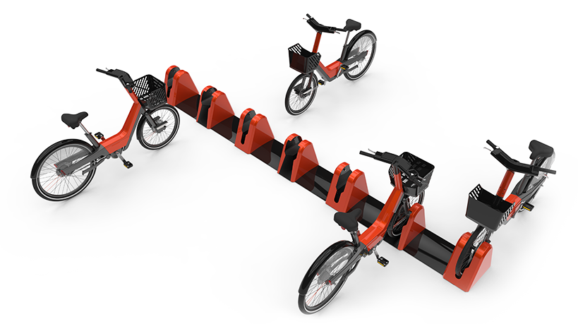
Results
Bike Stations

Slide 6
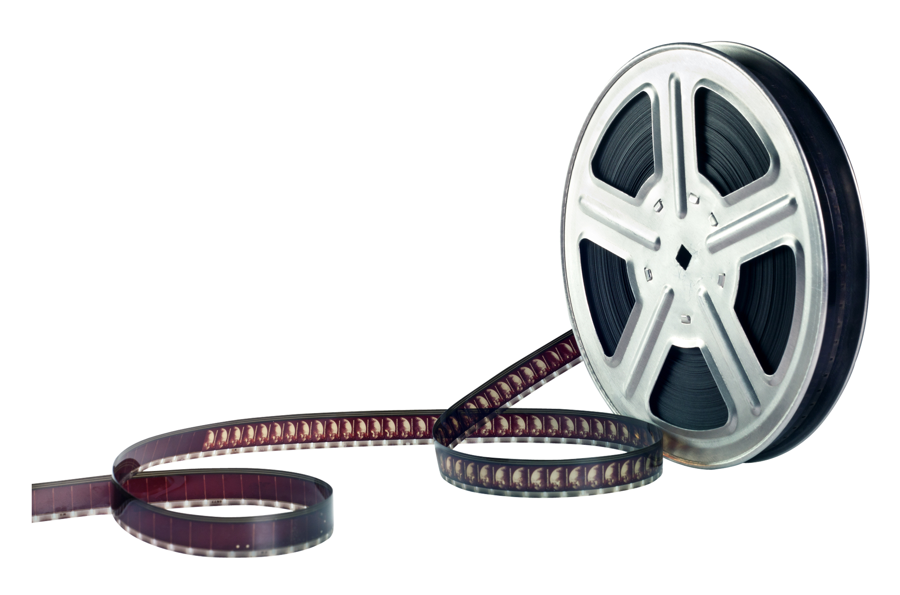
Results
Favorite Movie Analysis:
The Good, the Bad and the Ugly (1966)
The Shining (1980)
The Dark Knight (2008)
Inception (2010)

Slide 7
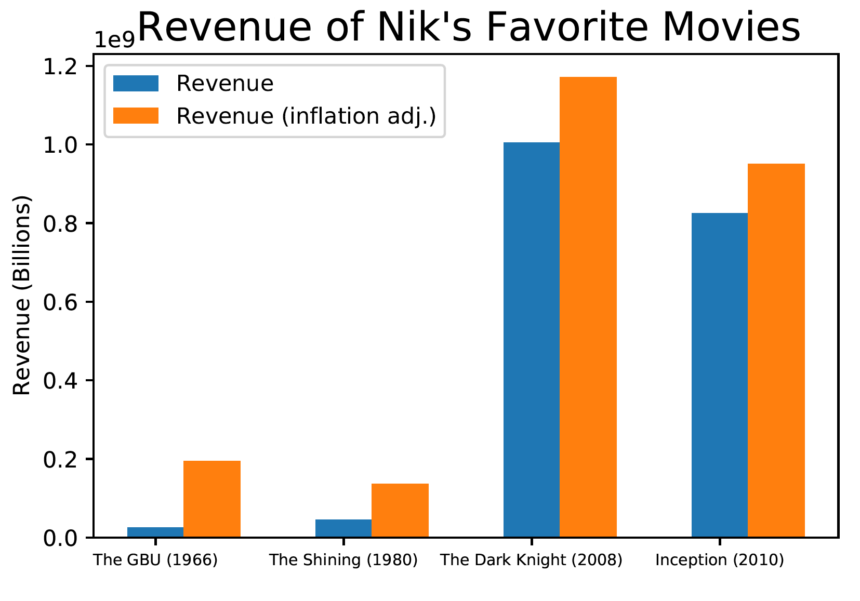
Results
Movie Analysis

Slide 8

Challenges
API documentation
Parsing
Pythonic Coding

